Slide 1

1st National Conference On "Intelligent Systems, Machine Learning & Data Science" (ISMLDS-2026) 30th March – 1st April, 2026 Buddha Institute of Technology GIDA, Gorakhpur
Job Recommender System Using Hybrid Filtering
Shreya Pandey | 2305251549010
Computer Science of Engineering – Data Science | 4th Year
Guide Name : Dr. Shashank Srivastava

Slide 2
Contents
Introduction
Problem Statement
Objectives
Literature Survey
Proposed Solution / Methodology
Results & Analysis
Conclusion & Future Work
Acknowledgements
References

Slide 3
Introduction
The rapid growth of online job platforms has created an overwhelming number of job listings, making it difficult for job seekers to find roles matching their skills and interests. Traditional keyword-based search often fails to capture context and relevance.
Efficient job matching is essential, as manual filtering is time-consuming and often inaccurate, leading to missed opportunities for both job seekers and recruiters. This creates the need for intelligent and personalized recommendation systems.
With advancements in AI, Machine Learning, and NLP, this project proposes HireHub, a hybrid job recommender system. It combines content-based techniques and popularity-based ranking to deliver relevant results through search and resume analysis.

Slide 4
Problem Statement
Existing job portals fail to provide accurate and personalized job recommendations. Traditional keyword-based search cannot effectively capture context, skills, and user intent.

Slide 5
Objectives
To develop an intelligent job recommender system that analyzes user queries and resumes to provide accurate and relevant job suggestions.
To implement a hybrid filtering approach combining content-based techniques and popularity-based ranking for improved recommendation quality.
To enhance user experience by enabling personalized, efficient, and context-aware job search through search-based and resume-based recommendations.

Slide 6
Literature Survey
Author & Year | Technique Used | Key Contribution | Limitation
Suryawanshi et al. (2025) | Hybrid (TF-IDF + NLP) | Automated resume parsing & TF-IDF matching | Requires structured resume data
Sangeetha et al. (2025) | Hybrid (TF-IDF + BERT) | Combines semantic understanding with text similarity for better accuracy | High computational cost and model complexity
Patidar et al. (2020) | Hybrid (TF-IDF + Popularity) | News rec. system using popularity-weighted TF-IDF | Suffers from cold-start and data sparsity problems

Slide 7
Literature Survey
Author & Year | Technique Used | Key Contribution | Limitation
Gupta & Singh (2020) | Content-Based Filtering (TF-IDF) | Effective text-based job matching using TF-IDF and similarity measures | Limited personalization, ignores user behavior
Verma & Xu (2023) | Collaborative Filtering | Uses user interaction data to recommend jobs based on similar users | Suffers from cold-start and data sparsity problems
Shrivastava et al. (2022) | Hybrid Filtering | Improve recommendation accuracy and relevance | Requires structured data and higher complexity

Slide 8
Proposed Solution / Methodology
Approach:
The proposed system, HireHub, is a web-based job recommender platform designed to provide personalized and relevant job suggestions.
It follows a hybrid recommendation approach, combining content-based filtering with a popularity-based component to improve accuracy and ranking.
The system supports two modes:
Search-based recommendation using user queries (role, location, experience)
Resume-based recommendation by extracting skills from uploaded resumes

Slide 9
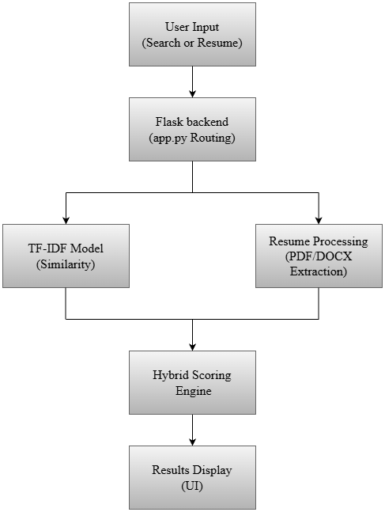
Proposed Solution / Methodology
TF-IDF Vectorization is used to convert job descriptions and user inputs into numerical vectors for comparison.
Cosine Similarity measures the relevance between user profile (query/resume) and job descriptions.
Resume Parsing & Skill Extraction techniques are used to extract meaningful information from PDF/DOCX resumes.

Slide 10
Proposed Solution / Methodology
The workflow includes user input → text processing → similarity calculation → hybrid scoring → ranked job results
Hybrid Scoring Mechanism

Slide 11
Proposed Solution / Methodology
A Hybrid Scoring Mechanism combines similarity scores with normalized popularity scores to improve recommendation quality.

Slide 12
Proposed Solution / Methodology
Tools & Technologies:
Python is used for implementing the recommendation system and machine learning components.
Flask is used for backend development, routing, and handling user interactions.
Pandas and NumPy are used for data preprocessing and numerical computations.
Scikit-learn is used for TF-IDF vectorization and cosine similarity.
PDFMiner, PyPDF2, and docx2txt are used for resume parsing and text extraction.
A web-based interface (HTML, CSS, JavaScript) enables job search, resume upload, voice search, and chatbot interaction.

Slide 13
Proposed Solution / Methodology
Dataset Source
Source: Kaggle
Dataset Name: LinkedIn Canada Data Science Jobs 2024
Dataset Size:
Rows: 315 rows (job listings)
Columns:10 columns (features)
It contains job-related information such as job title, company, location, skills, job description, and application count.

Slide 14
Results & Analysis
Graphs:
Hybrid Score Behavior

Slide 15
Results & Analysis
Graphs:
TF-IDF Similarity Distribution

Slide 16
Results & Analysis
Key Outcomes:
Hybrid approach improves accuracy and relevance of job recommendations
Combines text similarity and job popularity for better ranking
Supports both search-based and resume-based personalization

Slide 17
Results & Analysis
Interpretation:
TF-IDF and cosine similarity ensure context-aware matching of skills and jobs
Popularity score reflects real-world job demand and trends
Hybrid model balances user intent with market relevance

Slide 18
Results & Analysis
Comparison:
Criteria | Content-Based Filtering | Collaborative Filtering | Hybrid Approach (Proposed)
Data Used | Item features, skills | User interactions, ratings | Combines both
Personalization | Based on user profile | Based on similar users | More accurate personalization
Cold Start | Handles better | Major issue | Reduced impact
Accuracy | Limited | Moderate | High (best performance)
Limitation | Ignores popularity | Data sparsity, cold start | Slightly complex

Slide 19
Conclusion
Developed HireHub, a hybrid job recommender system combining content-based filtering and popularity-based ranking
Achieved improved accuracy and relevance in job matching using TF-IDF and hybrid scoring
Hybrid recommendation provides better results than single-method approaches
Balances user skills, preferences, and real-world job demand

Slide 20
Future Work
Skill Gap Analysis Identify missing skills required for recommended jobs.
Learning Resource Recommendation Suggest relevant courses and materials to help users acquire missing skills.
OCR-Based Resume Processing Use Optical Character Recognition (OCR) to extract text from scanned or image-based resumes
Advanced NLP Models Replace TF-IDF with models like BERT for improved semantic understanding.
User Personalization Use user behavior (clicks, saved jobs) to enhance recommendation accuracy.

Slide 21
Acknowledgements
I would like to express my sincere gratitude to my project guide, Dr. Shashank Srivastava, for his valuable guidance, support, and continuous encouragement throughout this project.
I also thank Buddha Institute of Technology, Gorakhpur, for providing the resources and environment to successfully complete this work.

Slide 22
References
Patidar, C. P., Sharma, M., & Katara, Y. (2020). Hybrid Recommendation System using TF-IDF and Popularity.
Sangeetha, N., Thangaraj, H., & Vashisht, V. (2025). A BERT-Based Hybrid Recommendation System.
Suryawanshi, S., Mali, P., & Rasal, S. (2025). Resume Parsing and Job Recommendation using NLP and Machine Learning.
Shrivastava, et al. (2022). Hybrid Recommendation Systems for Job Matching.
Chen, et al. (2023). HybridBERT4Rec: Deep Learning-Based Job Recommendation Model.
Sharma, et al. (2021). TIMBRE: Scalable Job Recommendation Framework.
Gupta & Singh (2020). TF-IDF Based Job Recommendation Techniques.
Verma & Xu (2023). Machine Learning Approaches for Resume Parsing and Job Matching.
Kaggle Dataset: LinkedIn Canada Data Science Jobs 2024.

Slide 23
Thank You

